Slide 1
Strategies for engineering stress tolerance

Slide 2
INTRODUCTION
Crop plants are subject to range of external factors that adversely affect their growth and development.
These affects are environmental affect like Temperature, water availability and salinity on crop plants.

Slide 3
Stresses on crop plant
Stress on crop plant can be of different types.
Biotic
Abiotic
Temperature stresses ( Water deficit)
All these type of stresses affect the yield of plant crops. There is variation in yield because of Biotic and Abiotic stress, the average yield of wheat from one year to the next is just 13%. And it also affect the other crops as well.

Slide 4
Cont
Improving the tolerance of crops to Abiotic stress could therefore enable them to maintain growth and development during the normal fluctuations of adverse conditions.
In the longer term the depletion of ozone layer and climate change associated with global warming which become the cause of more environmental stress on crop plants.

Slide 6
The nature of Abiotic Stress
Plant depends largely upon internal mechanism for tolerating variations in the external environment.
Plants are adapted to function in a fluctuating environment and normal external changes without detriment to growth and development.
Abiotic stresses to which plants are exposed Different strategies are required to engineer a particular type of stress tolerance.

Slide 7
The nature of water deficit stress
It inhibits photosynthesis, increase the conc. Of toxic ions, and remove the protective hydration shell around macromolecules.
It is a situation in which demands for water is exceeds supply, supply is determined by the availability of water in the soil to the roots and demand is determined by the plant transpiration rate.
Two parameters for water status of plant cells:
Water potential
Relative water content

Slide 8
Water potential
It is measured in units of pressure(maga-Pascals) and is similar in concept to electric potential in which current flows from a compartment of high potential to low potential.
Water potential can be determined by the osmotic potential or the concentration of solute, and the physical pressure of the cell and the tissues boundaries.

Slide 9
The osmotic potential is generally lower than the water potential and the turgor potential is the difference between them.
Leaf turgor is lost when turgor potential is zero.
As leaf turgor falls then stomata close to reduce transpiration.
When turgor is lost the leaf cell collapse and the leaf wilts.

Slide 10
These effects have the result of reducing water loss from the leaf by closure of stomata.
Wilting and rolling up of leaves reduces their exposure to sunlight.
Reduction in stomatal conductance can cause reduction in photosynthetic assimilation. So the turgor and transpiration maintenance is important to maintain the growth of plant under drought stress.

Slide 11
Osmotic adjustment:
Turgor could be sustained either by keeping the leaf water potential high or by reducing the osmotic potential. The latter can be achieved by solute accumulation and a process called osmotic adjustment.

Slide 12
Different Abiotic stresses create a water deficit
Drought
Ambient temperature
High salt conditions
They result in the efflux of cellular water, lead to plasmolysis and eventually cell death.

Slide 14
Plants may respond to water deficit by the accumulation of compatible solutes or osmoprotectants which is a broad strategy for countering water deficit stress.
Different plant species produces different compatible solutes foe example Manitol is produced by celery in response to salt stress, whereas spinach accumulate glycine betaine.

Slide 15
Targeted approach to manipulate tolerance to specific water deficit stresses individual stresses may susceptible to specific mechanism to improve tolerance

Slide 16
Alernative approach to salt stress
Salt tolerance is increasingly becoming major target for crop improvement as irrigated lands are damaged by accumulation of salt.
There is pressure to grow crops on such saline conditions,with poorer quality water.
Saline conditions lead to osmotic stress by preventing water uptake from roots.

Slide 17
Accumulation of salts cause Toxicity
Na+ and Cl ions in cytoplasm have direct Toxic Affects by inhibiting
Protiens Synthesis
Photosynthesis
Certain enzmymes

Slide 18
Strategies for engineering salt stress by production of compatible solutions.
Provide protection against osmotic effects of saline but not its toxicity.

Slide 19
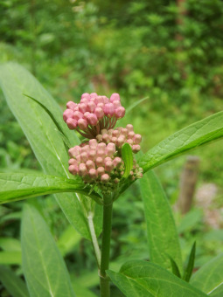
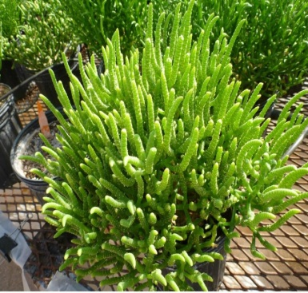
Startegies for Engineering Salt Stress
Strategies have been developed by comparing response of Glycophytes and Halophytes.
Glycophytes:
“Plants sensitive to High Salt Conditions”
Halophytes:
“Plants resistant to High Salt Conditions”

Slide 20
What Makes Halophytes Resistant to Salt stress?
Halophytes excrete salts via specialized glands on their leaf surfaces.
Vacuoles are important for osmotic balance

Slide 21
Approaches to enhance Salt Tolerance
Enhancing salt stress by copying strategies used by halophytes
Use of Transport protiens( antiport Protiens) by coupling to Proton pump (AVP1) ie: Vacuolar Na+/H+ antiport protien AtNHX1
Tomato and Rice yield
Enhancing Vacuolar Transport by Overexpressing the gene encoding AVP1 which in result increases the proton pump potential of vacuole
Drought tolerance
Overexpression of Na+/H+ antiporter AtSOS1
gene for salt tolerance of callus cultures

Slide 22
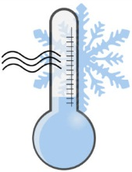
Alternative approach to cold stress
Different plants vary enormously in their ability to withstand cold and freezing temperatures.
Cold tolerance is one traits that plants breeders have
Tropical plants have virtually no capacity to survive a range of -5 to -30 C depending upon species.
Plants from colder regions are better able to withstand cold or freezing temperatures even lower than this.

Slide 23
Period of cold acclimation
The plants are better able to withstand cold stress if they undergo a period of cold acclimation,at a low but non-freezing temperature.e.g:
Wheat plants grown at normal warm temperatures are killed by freezing at -5 C,but after a period of cold acclimation when plant grow at temperatures below 10 C,they can survive freezing temperature down to -20 C.

Slide 24
Cold induced protiens
Cold induced protiens are group of protiens encoded by a class of genes designated as COR (Cold-responsive) genes.
Precise function of these cold-induced genes is not known yet,but they contribute directly to freezing tolerance but have potentially damaging affects of dehydration assosiated with freezing.
Over expression of cold induced protiens helps to tolerate cold.

Slide 25
COR and Heat shock Regulons

Slide 26
A number of cold induced/drought responsive genes contain the DRE sequence in their promoters,which is bound by CBF1 family,activating transcription and hence induce expression of tolerance to the cold/drought.
Heat shock induced genes also contain HSE(Heat shock element) that induce expression of several heat shock protiens.

Slide 27
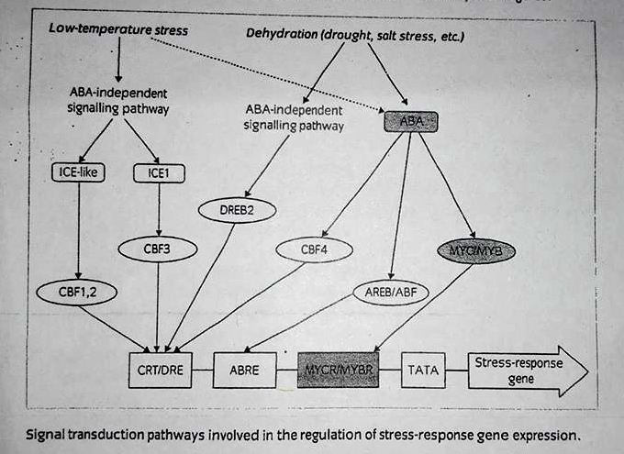
Transcriptional regulation by low temperature and dehydration signalling pathways
ABA signalling pathway
ABA independent signalling pahway

Slide 28
CRT/DRE element is responsive to four signalling pathways:two low temperature signalling pathways via ICE1 and ICE like protiens,and two distinct dehydration signalling pathways:ABA and ABA independent signal transduction.
ABA independent signalling involves the activation of BREB2 transcription factor,while one of many effects of ABA signalling is the activation of CBF4.ABA also mediates the activity of several transcription factors,that bind to ABA response elements (ABREs).These bind to the MYCR/MYBR elements found in several ABA responsive genes.

Slide 29
Tolerance to heat stress
Tolerance to heat stress is only possible due to specific set of heat shock protiens(HSPs).
Types of Heat shock protiens:
HSP100
HSP90
HSP70
HSP60 (function as molecular chaperones)
Small HSPs (funcion not clear)

Slide 30
HSPs have been transformed into plants to enhance heat tolerance
Some of the transgenes used to manipulate heat tolerance:

Slide 31
When the AtHSF1 gene was overexpressed in Arabidopsis,the transcription facor was not active,and there was no affect on thermotolerance.
However, fusion of AtHSF1 to the N or C terminus of the gusA reporter gene produced a fusion protien in Arabidopsis that expressed HSPs and demonstrated enhanced tolerance.

Slide 32
Secondary Effects of Abiotic Stress
Many not all forms of environmental stress (abiotic and biotic) result in oxidative stress.
Occurs due to ozone pollution and ionizing radiation.
Oxidative Stress :
Secondary effect of many type of stress ,from pathogen attack to water-deficit stress.
Arises due to production of free radicals and forming subsequent cascade of reaction.
Induces damage to cell occurs as a result of formation of ROS.

Slide 33
Oxidants act as ROS
Plants contain a number of enzymes.
Catalyzes the cascade of ROS and convert into less reactive products.
Key enzymes in neutralizing the ROS.
Super oxide dismutase (SOD)
Catalase
Peroxidase

Slide 34
Antioxidants in Plants
Antioxidants that react with the activated oxygen compounds to produce harmless products includes;
3 different vitamin compounds
β-carotene
Ascorbic acid
α-tocopherol
Other compounds includes
Glutatione
Zeaxanthine

Slide 35
L- Ascorbic Acid
Reductant for many free radicals
Minimize the oxidative stress
Glutathione
It is tripeptide
GSH functin directly as free radical scavenger reacting with singlet oxygen, hydroxyl radical and superoxde
Scavange ROS with or without enzymes
React with second oxidized GSH to disufide GSSG

Slide 36
α-Tocopherol
Membrane bounded scavenger of oxygen free radicals and singlet oxygen
Caroteniodes
They protect photosystems detoxifying ROS
Serve as membrane stabilizing agent
React with singlet oxygen and dissipate the energy

Slide 37
Ascorbate-Glutathione cycling.
Central to this antioxidant system is ascorbate-Glutathione cycling.
Most extensively characterized in chloroplast.
Chloroplast produce superoxide and hydrogen peroxide in light from photosytem Ⅰ
Superoxide itself is converted to H₂0₂ by dismutation activity or SOD activity.
H₂0₂ is scavenged by ascorbate and ascorbate peroxidase.

Slide 39
Monodehydroascorbate produced by two ways in this reaction.
By reduction of NADPH catalyzed by Monodehydroascorbate reductase.
By dismutation of two Monodehydroascorbate molecules to form dehydroascorbate, follwed by reduction of i.e
Dehydroascorbate by glutathione

Slide 40
General Strategies for engineering Stress Tolerance
From the outline of plant oxidants and oxygen scavenging activities ;the two general strategies are
To increase the level of enzymes that remove ROS.
To increase the level of antioxidants that react with ROS.

Slide 41
Strategy 1: Expression of enzymes involved in Scavenging ROS
SODs Catalyse the reaction
Superoxide + 2H⁺ O₂ + H₂O₂
The activity of SODs determines the concentration of the two substrates to form OH⁺.
There is a broad range of SODs
Require metal ions for activity present in different cellular compartments
Fe , Mn, Cu/Zn

Slide 42
Classification of SODs
There are three main forms of SODs classified on the basis of metal co-factor attached.
Copper/Zinc (Cu/Zn-SOD) Cytosol
Manganese (Mn/SOD) Mitochondria
Iron (Fe/SOD) Chloroplast
All of these are produced depending upon the degree of oxidative stress experienced by the subcellular compartments

Slide 43
Transgene used to Engineer tolerance to Oxidative stress
Transgenic Tobacco Plant :
Containing each class of SODs are produced
Tested for the ability to withstand Oxidative stress i.e exposure to Ozone
Transgenic Alfalfa Plant:
Mn-SOD are transformed in this plant
Targeted to chloroplast and mitochondria
3 year trials were done
Introduction of Cu/SOD ,Mn/SOD and Fe/SOD genes together are shown to increase the winter hardiness of crop

Slide 44
Gene | Host | Stress tolerance
Mitochondrial Mn-SOD ,tobacco | Alfalfa chloroplast | 2x increase in SOD , increased field drought tolerance, freezing tolerance
Mitochondrial Mn-SOD ,tobacco | Tobacco chloroplast | 2-4x increase in SOD ,increased ozone tolerance
Mitochondrial Mn-SOD ,tobacco | Tobacco mitochondria | 8x increase in Sod ,no effect on ozone tolerance
Arabidopsis Fe-SOD | Tobacco | Protected plants from ozone damage
Glutathione reductase , E.Coli | Tobacco chloroplast | 3-6x increase in SO2 tolerance

Slide 45
Strategy 2: Production of Antoxidants
The three Antioxidants are:
Ascorbate peroxidase
Glutathione peroxidase
Glutathione reductase.
These are transformed in Arabidopsis and Tobacco plant shown to have some effect on tolerance to abiotic stress such as
Stress
Cold
Salinity

Slide 46
Glutathione reductase
Provide resistance to oxidative stress.
Simply increasing the cellular concentration of glutathione by expressing glutathione synthase had no effect on stress tolerance

